Slide 1

NSG Pilkington – University of Liverpool Machine Learning Project: 02/12/2020
Dr. Peter Green
Diego Echeverria
Risk Institute,
School of Engineering

Slide 2



Multiple linear regression model structure
$${\hat{y}}_{t+1}=f(y_{t}, x)$$
$${\hat{y}}_{t+2}=f({\hat{y}}_{t+1}, x)$$
$${\hat{y}}_{t+3}=f({\hat{y}}_{t+2}, x)$$
We would also like to be able to vary the time lags randomly, so that we can optimise them later.

Slide 3
Processing lagged tag data to be used as inputs
Adjust time lag
data shift
to remove
X=roll(data, shift)
Del(X[: to remove])
X

Slide 4
Processing lagged tag data to be used as inputs
Max lag
Fault
Density
future pred
Time
Tag 1
Time
Tag 2
Time
Now

Slide 5
Processing lagged tag data to be used as inputs
Adjust for time lags…
Max lag
Fault
Density
future pred
Time
Tag 1
Lag 1 + future pred
Time
Tag 2
Time
Now

Slide 6
Processing lagged tag data to be used as inputs
Adjust for time lags…
Max lag
Fault
Density
future pred
Time
Tag 1
Lag 1 + future pred
Time
Tag 2
Lag 2 + future pred
Time
Now

Slide 7
Processing lagged tag data to be used as inputs
Remove data where we can’t realise predictions
Max lag
Fault
Density
future pred
Time
Tag 1
Time
Tag 2
Time
Now

Slide 8
Processing lagged tag data to be used as inputs
Adjust time lag
data=tag data shift=lag + future prediction
to remove=max lag + future prediction
X=roll(tag data, lag + future prediction)
Del(X[: max lag + future prediction])
X

Slide 9
Processing furnace fault data to be used as outputs
Adjust time lag
data=fault data shift=0
to remove=max lag + future prediction
X=roll(fault data, 0)
Del(X[: max lag + future prediction])
X

Slide 10
Processing lagged furnace to be used as inputs
Max lag
Fault
Density
future pred
Time
Time
Now

Slide 11
Processing lagged furnace to be used as inputs
Max lag
Fault
Density
future pred
Time
future pred
Time
Now

Slide 12
Processing lagged furnace to be used as inputs
Max lag
Fault
Density
future pred
Time
future pred
Time
Now

Slide 13
Processing furnace fault data to be used as inputs
Adjust time lag
data=fault data shift=future prediction
to remove=max lag + future prediction
X=roll(fault data, future prediction)
Del(X[: max lag + future prediction])
X

Slide 14
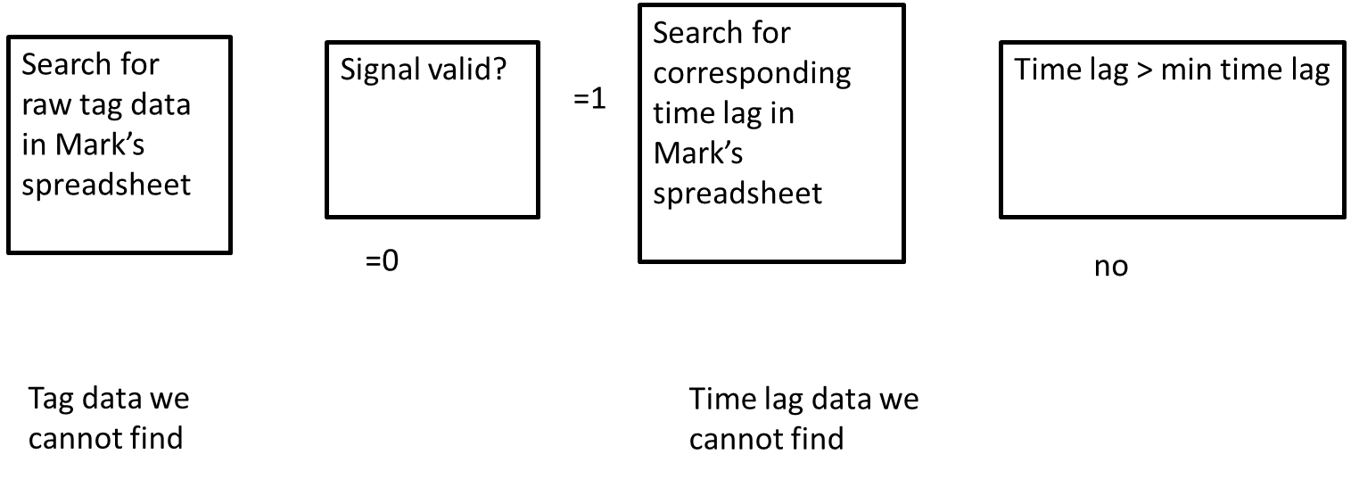
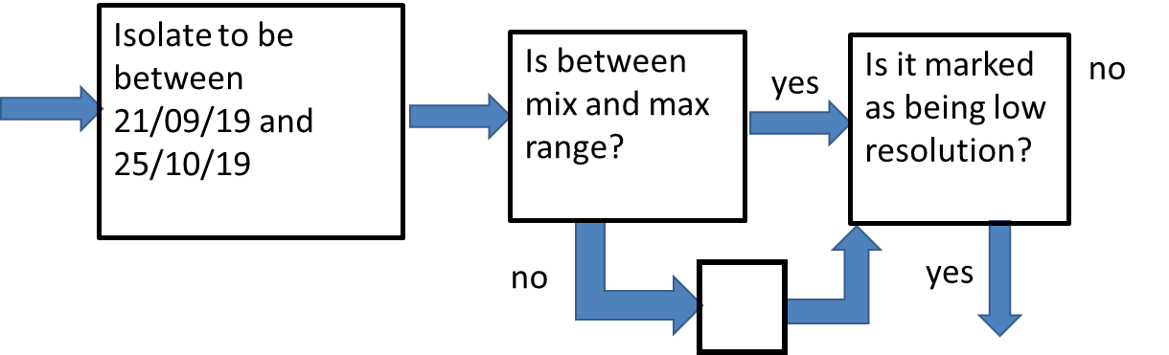
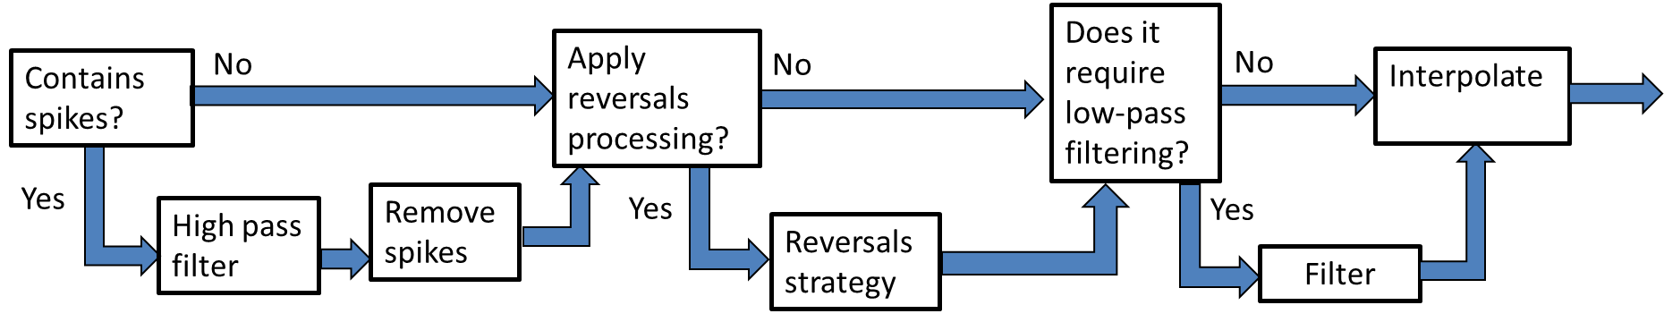
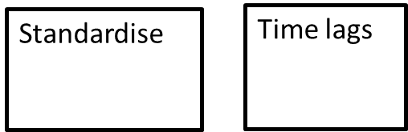
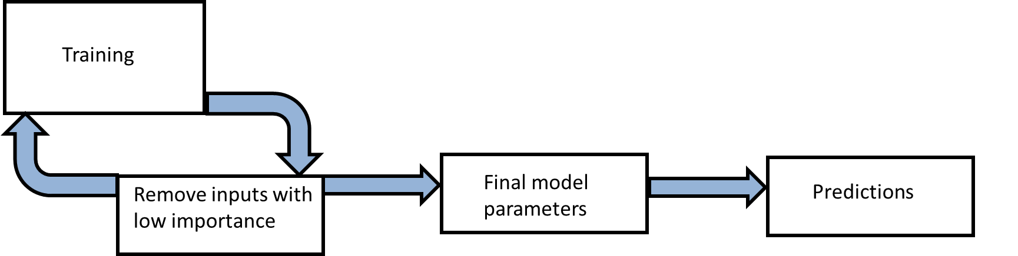
Checked code by re-running the current model using pipeline 9

Slide 15
Checked code by re-running the current model using pipeline 9
Data processing
Machine Learning
Note: signals affected by reversals are processed and filtered if required, but pipeline 9 does not yet include the ‘combination approach’ (more on this later)

Slide 16
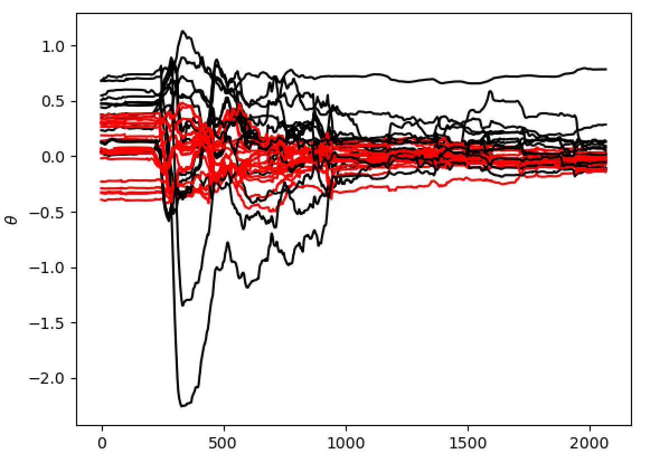
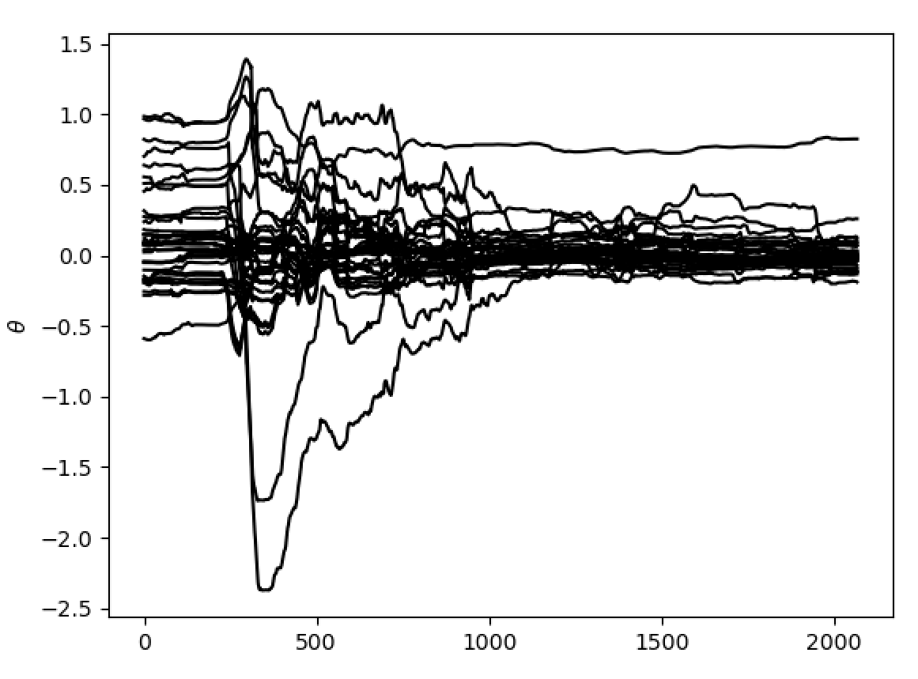

Slide 17
First 200 points are used to give starting point for parameter estimates
Looks like a degree of convergence

Slide 18
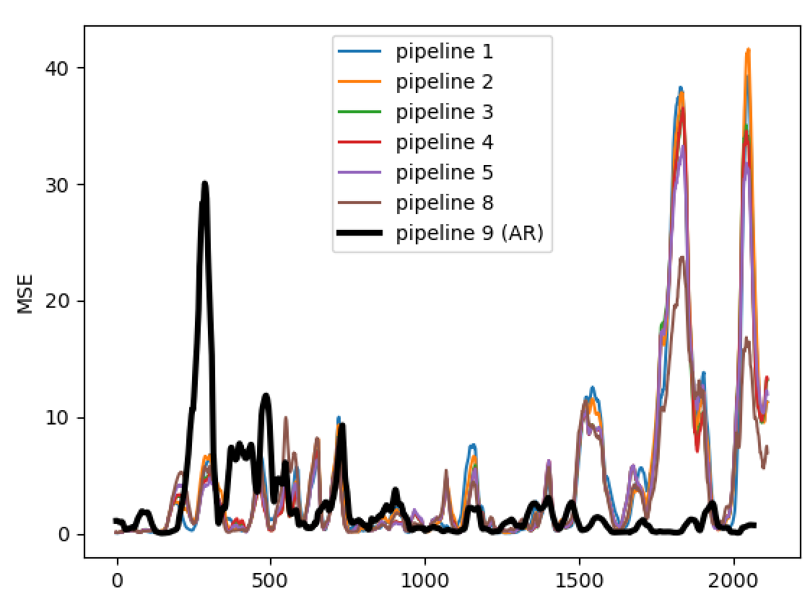
Pipeline | Av. RMSE
1 | 4.59
2 | 4.70
3 | 4.31
4 | 4.30
5 | 4.31
6 | 4.50
7 | 4.27
8 | 4.25
9 | 4.18
9 (AR) | 2.39

Slide 19
Pipeline | Av. RMSE
1 | 4.59
2 | 4.70
3 | 4.31
4 | 4.30
5 | 4.31
6 | 4.50
7 | 4.27
8 | 4.25
9 | 4.18
9 (AR) | 2.39
Learning phase?

Slide 20
Pipeline | Av. RMSE
1 | 4.59
2 | 4.70
3 | 4.31
4 | 4.30
5 | 4.31
6 | 4.50
7 | 4.27
8 | 4.25
9 | 4.18
9 (AR) | 2.39
Video…

Slide 21
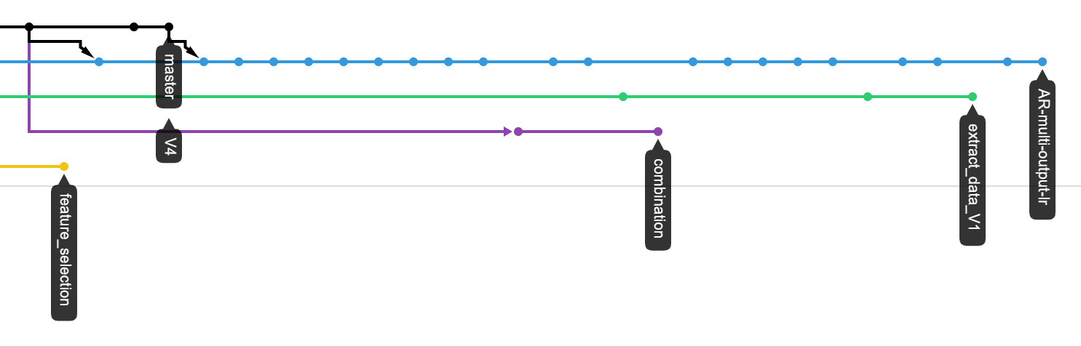
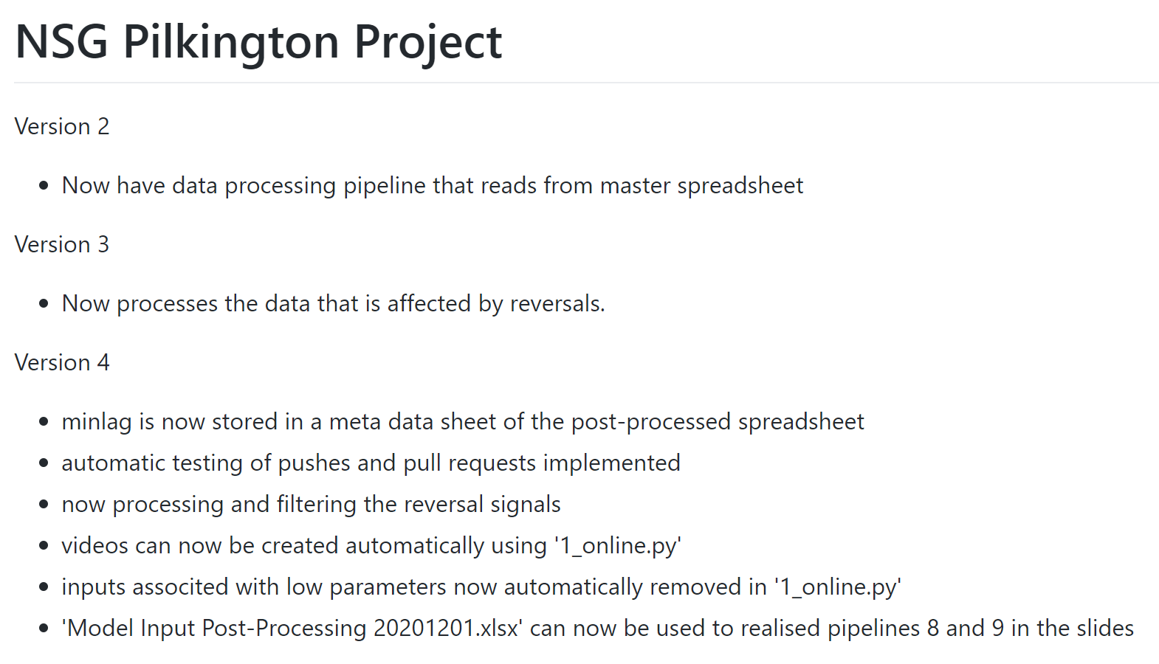
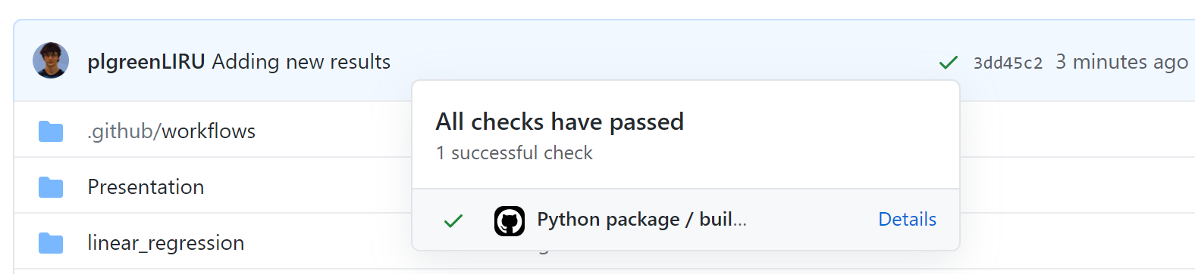
Code Management

Slide 22
Code Management
Branched development
Version controlled
Automatic testing

Slide 23
New tasks
Additional testing
Plot original furnace faults on top of processed furnace faults in video
Plot parameter estimates in video
Include all parameters in the pipeline flow chart (theta cut-off, standardisation etc.)
Now time to load a separate validation data set
Repeat with randomised time lags (code already written)
New recursive model structure certainly worth investigating but would suggest postponing until the above are complete.

Slide 24
To-do (short-term)
Run the pre-processing tasks defined in the flow chart with the 170 inputs specified in the spreadsheet “UK5 AI Furnace Model Input Pre-Processing”.
Results from the combination pre-processing task
Identify groups of correlated tags using the correlation coefficient.

Slide 25
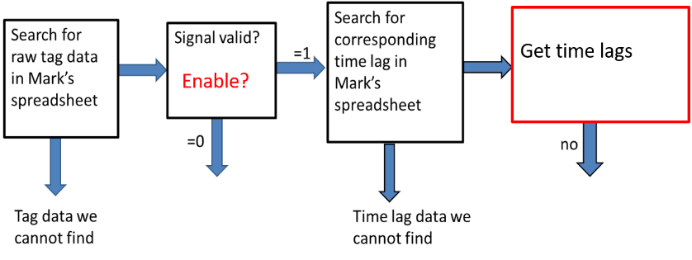
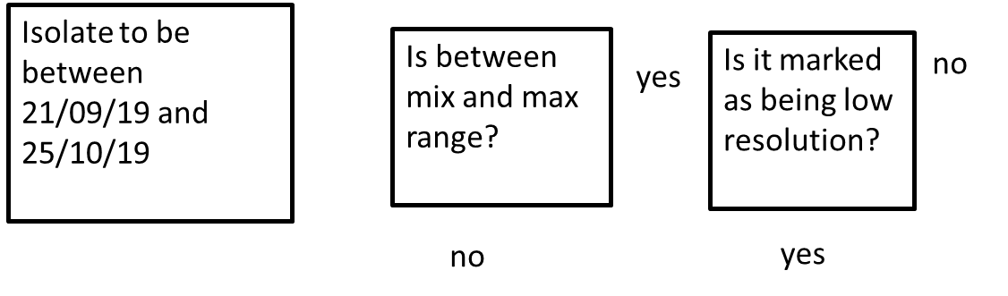
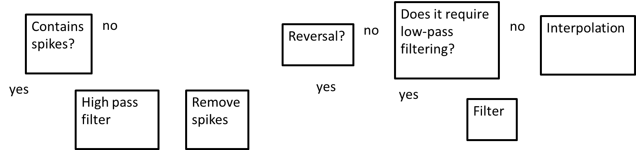
Changes in the pipeline for the inputs in the «UK5 AI Furnace Model Input Pre-Processing» file
Data pipeline 2
Zoom in
Changes are only needed in the red section of the pipeline

Slide 26
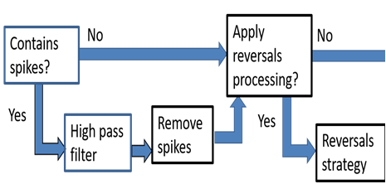
New pre-processing units and the new order
1
No
Apply Low-pass filter
No
Combine tags?
Resolution
Interpolate
0
Yes
Yes
Combine
Filter

Slide 27
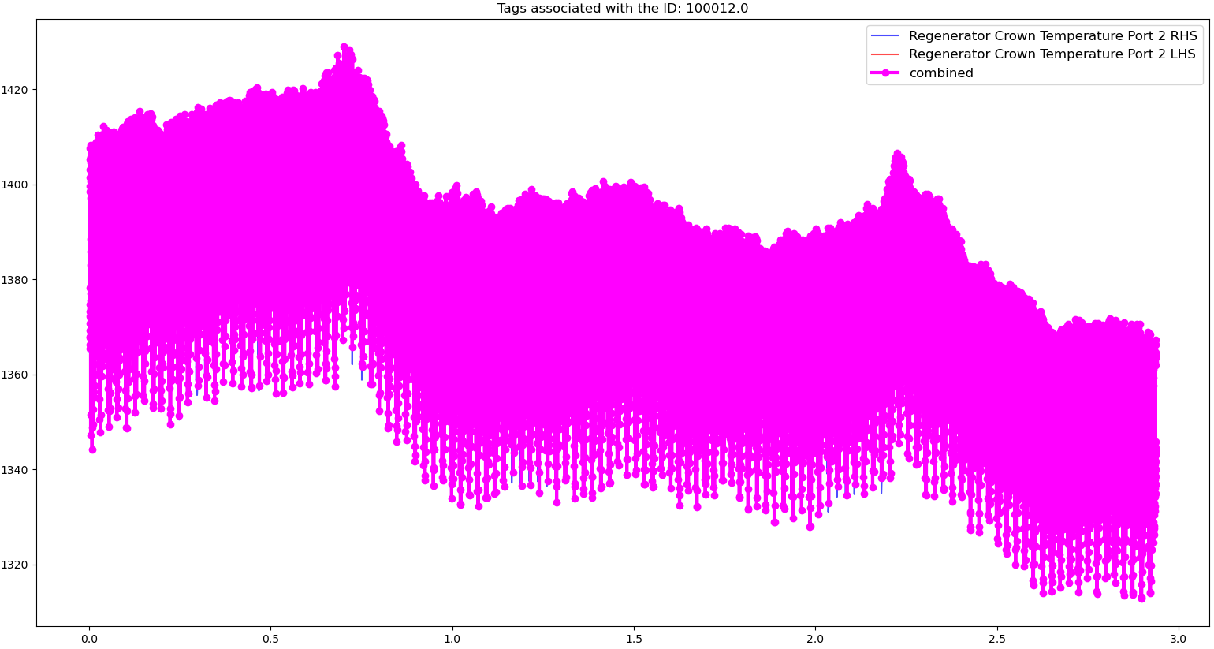
Standard combination

Slide 28
Standard combination
Zoom in

Slide 29
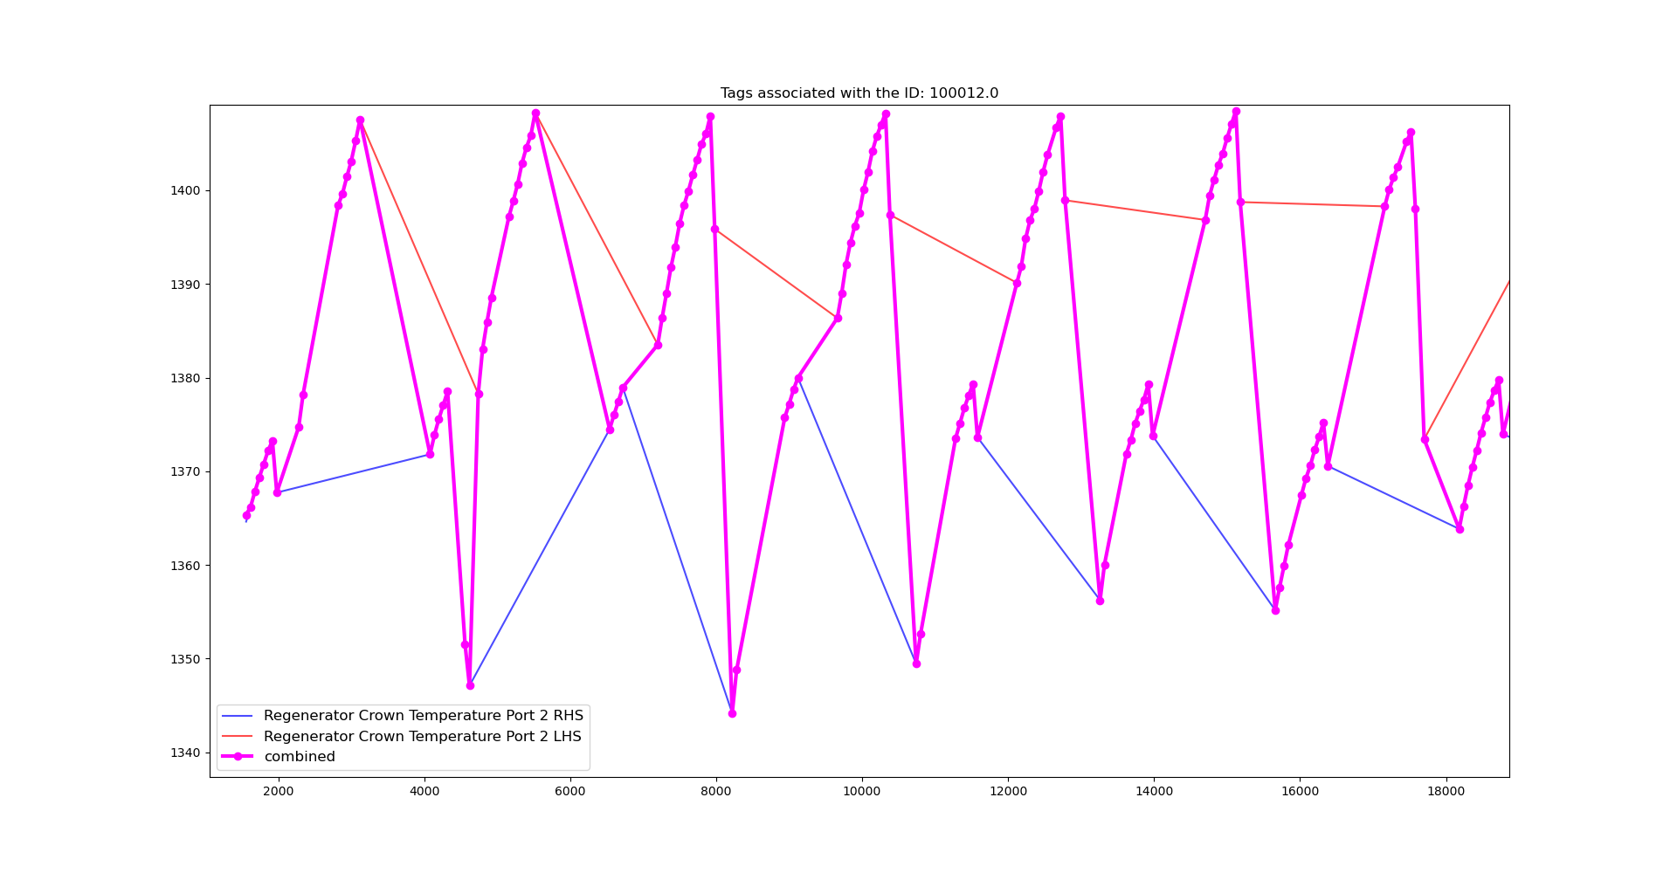
Standard combination:

Slide 30
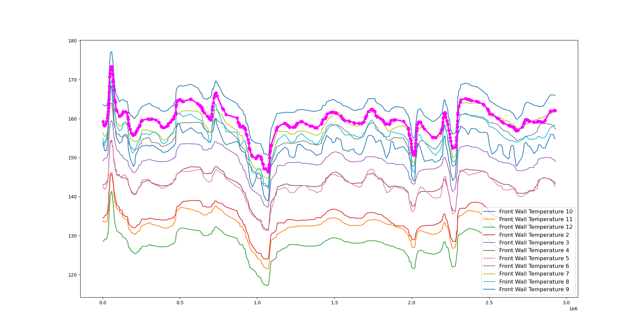
Special case 1
Combined

Slide 31
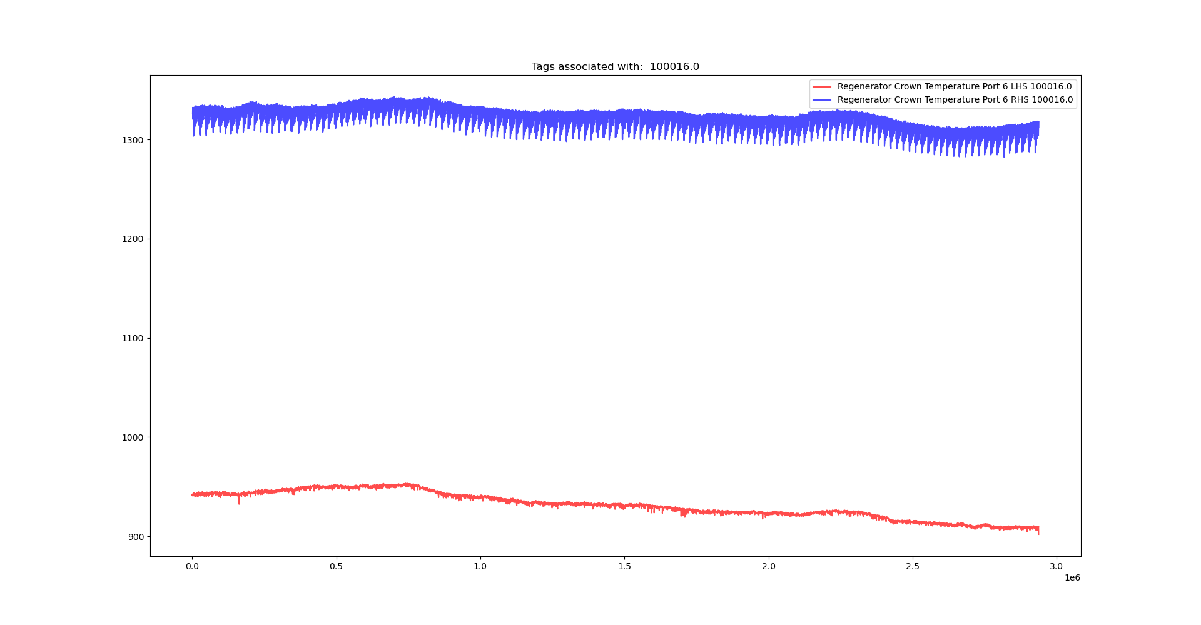
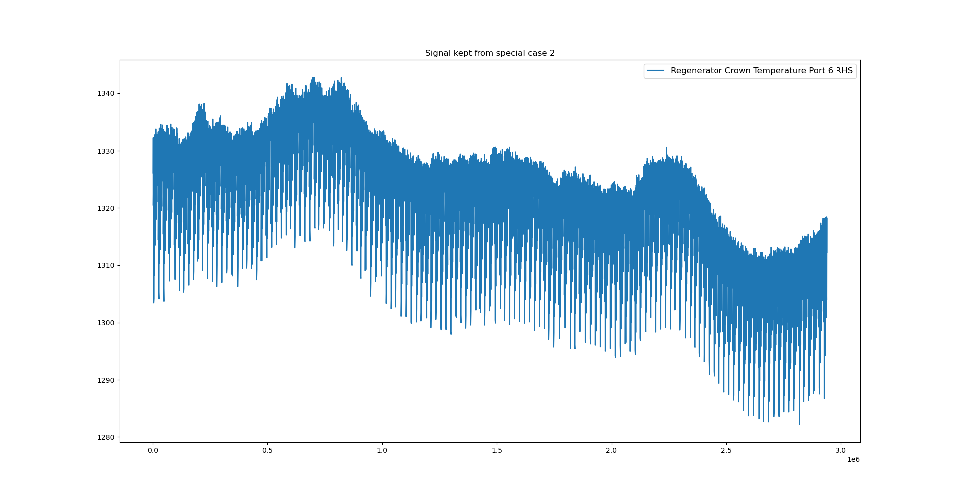
Special case 2

Slide 32
Examples after interpolation
1
No
Apply Low-pass filter
No
Combine tags?
Resolution
Interpolate
0
Yes
Yes
Combine
Filter

Slide 33
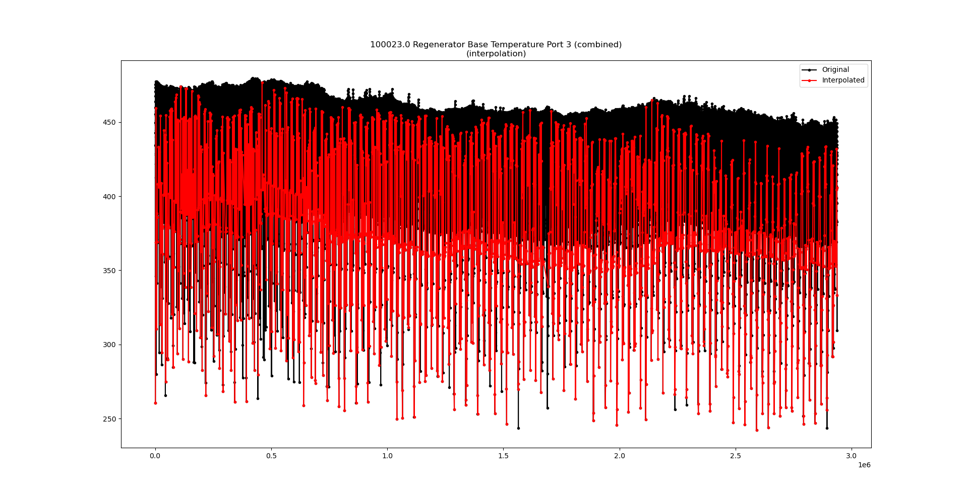
Examples after interpolation

Slide 34
Examples after interpolation
Zoom in

Slide 35
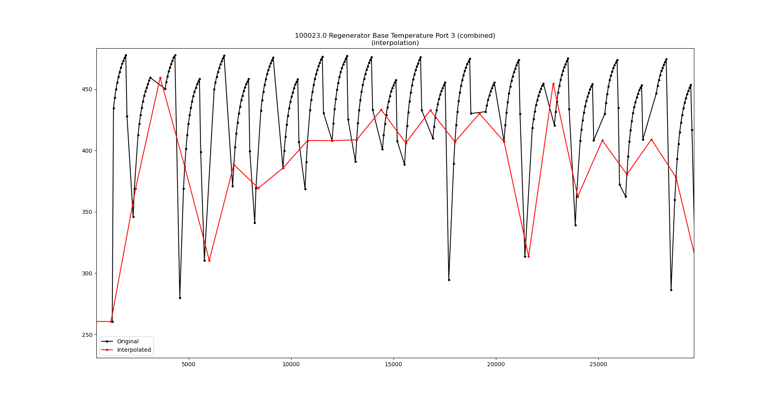
Examples after interpolation

Slide 36
Signals that will not have predictive potential
The resultant number of inputs from the pre-processing pipeline is N = 105.
We detected 3 signals that are worth to have a look.

Slide 37
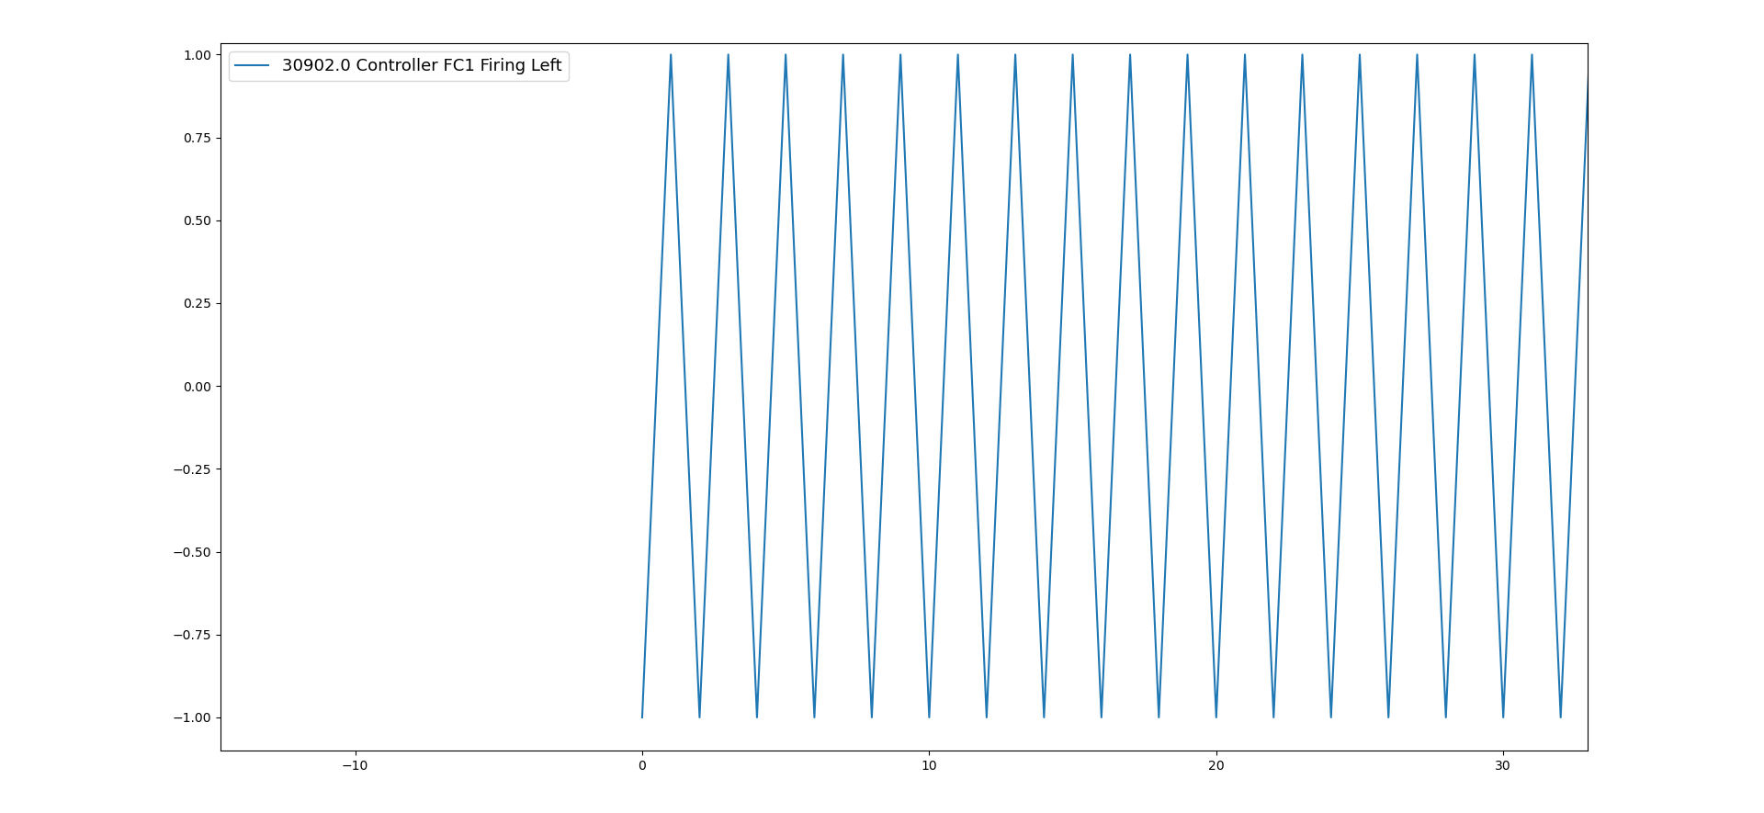
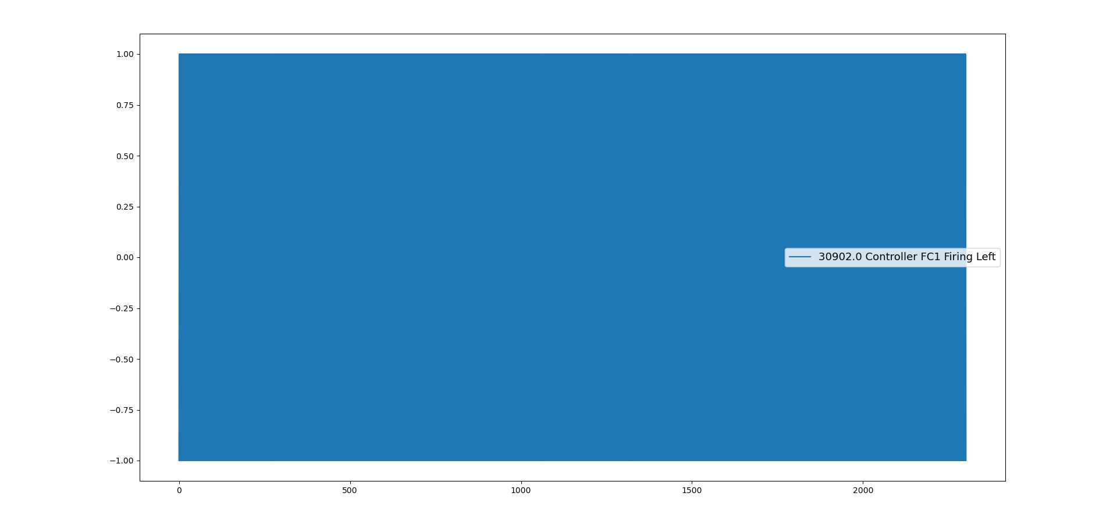
Zoom in
Signals that will not have predictive potential
Only 1 and -1 values along the time period.
Tag ID: 30902
Controller FC1 firing left

Slide 38
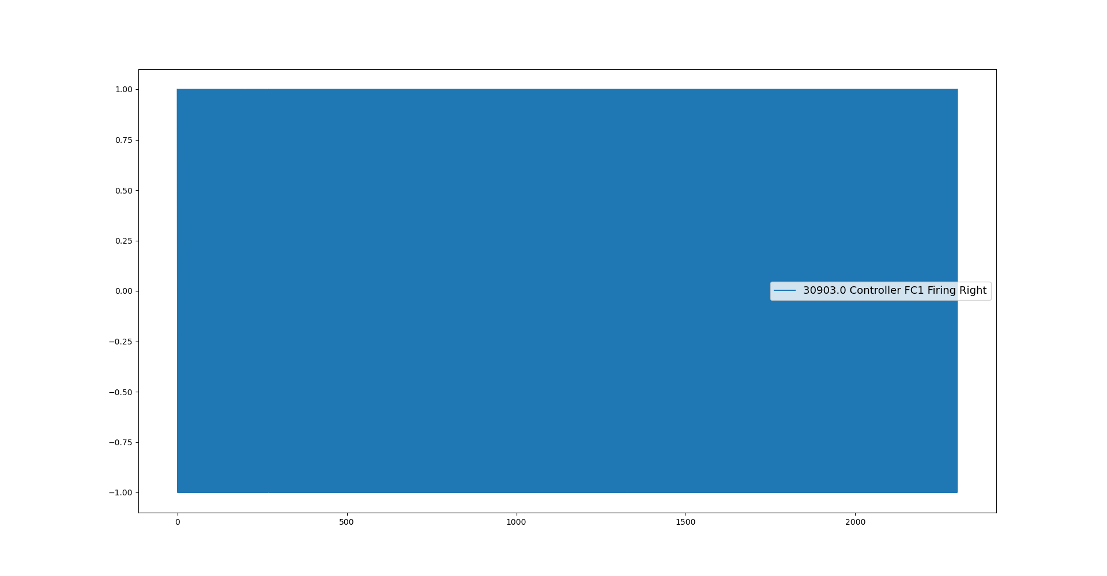
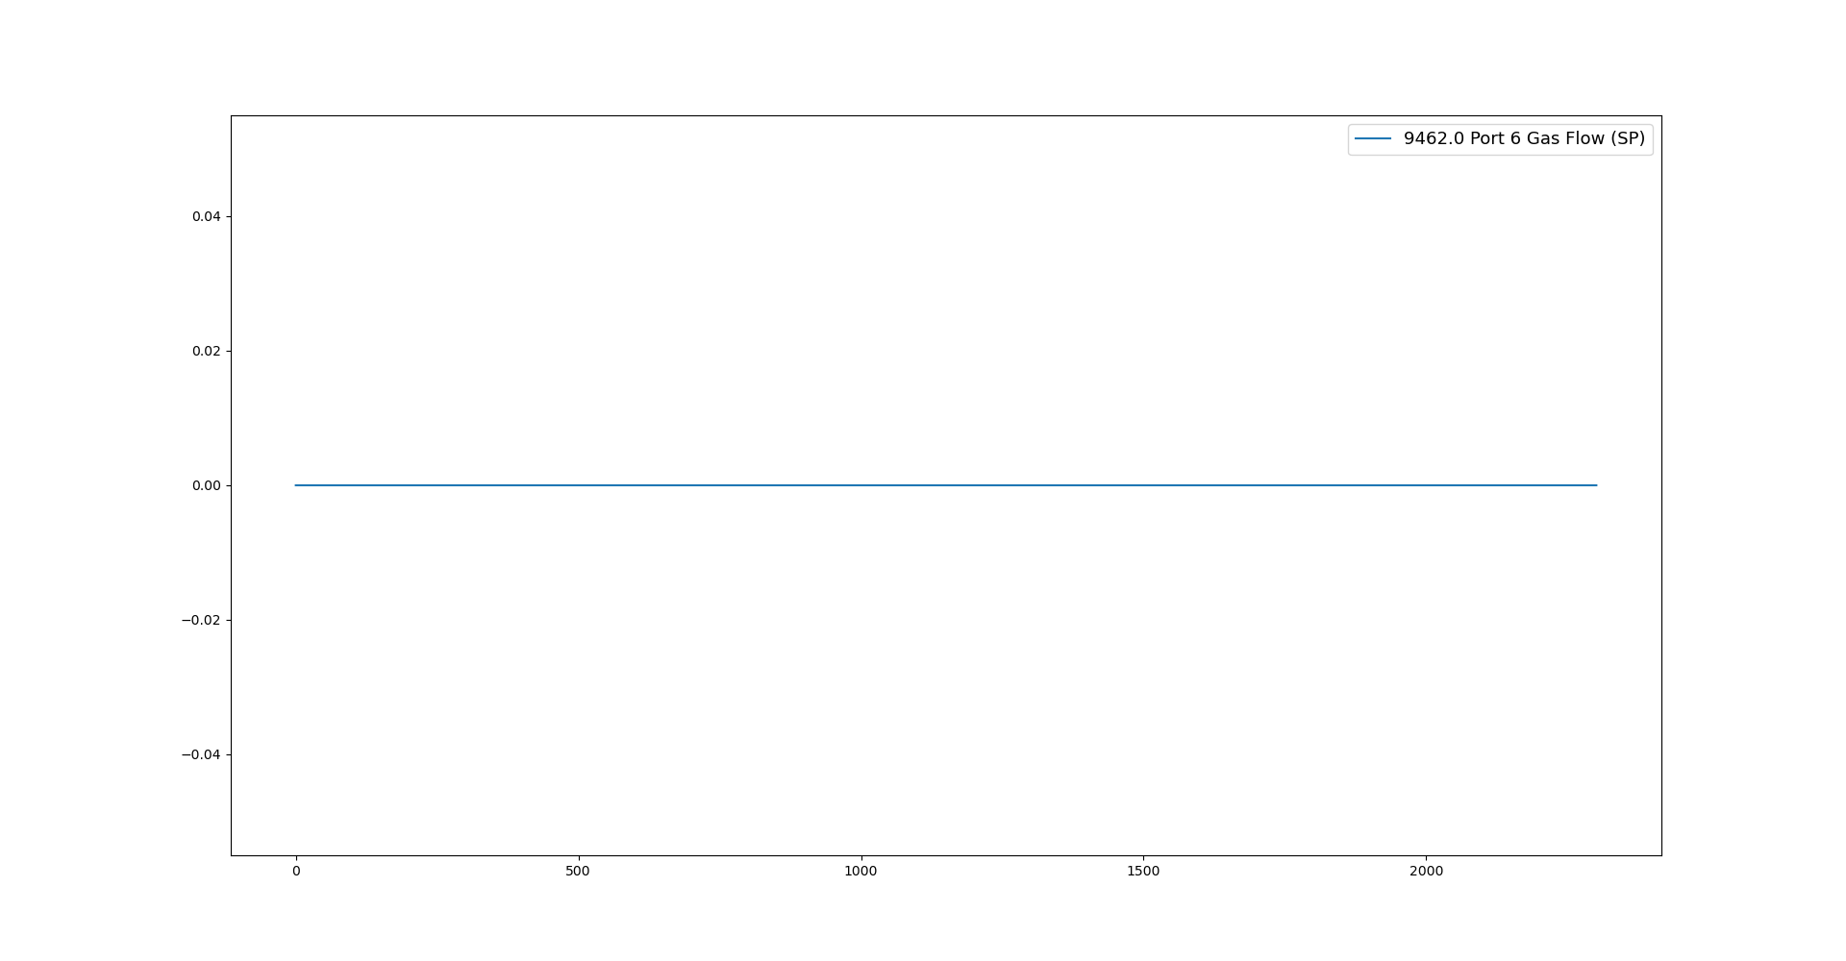
Signals that will not have predictive potential
Tag ID: 30902
Controller FC1 Firing Right
Tag ID: 9462
Port 6 Gas Flow

Slide 39
To-do (short-term)
Run the pre-processing tasks defined in the flow chart with the 170 inputs specified in the spreadsheet “UK5 AI Furnace Model Input Pre-Processing”.
Results from the combination pre-processing task
Number of correlated groups identified
Identify groups of correlated tags using the correlation coefficient.

Slide 40
Identify correlated inputs
We eliminated the 3 signals specified in the previous slides.
We run the correlation analysis with the remaining N = 102 inputs.
The correlation analysis detected 21 correlated groups and 41 uncorrelated tags.
Once the team eliminate the correlated tags, the final training dataset is going to be assembled.

Slide 41
Thank you for your attention. ANY QUESTIONS?

